Slide 1
Soccer: Most valued player’s attributes
Andrew Jalnine

Slide 2
Dataset
Used European Soccer Dataset from www.kaggle.com

Slide 3
Motivation
To select players for team its important to know what player’s attributes most valued
We can find how player’s overall rating depends of different attributes

Slide 4
Research Question(s)
How we can separate goalkeepers and other field players attributes?
Which player’s attributes most highly correlated with overall rating
Check is results correct

Slide 5
Findings
We found that check of specific goalkeepers attributes (like gk_giving) can help to separate goalkeepers from all other field players

Slide 6
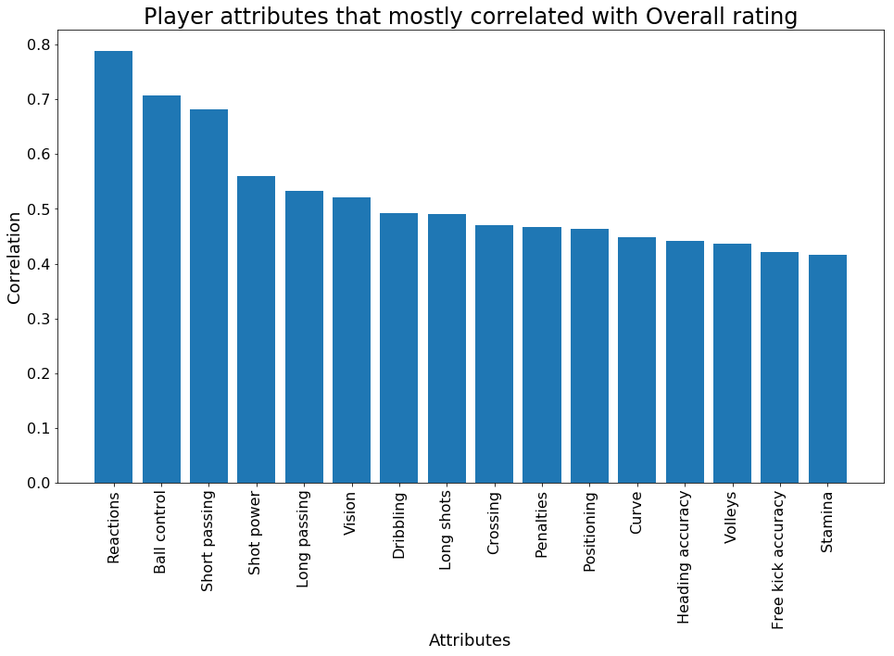
Findings
2. We found valued attributes:

Slide 7
Findings
Top most valued attributes is:
Reactions
Ball control
Short passing
This knowledge can be used during selection players in new or existing teams

Slide 8
Acknowledgements
No any feedback got yet

Slide 9
References
NumPy is the fundamental package for scientific computing with Python.
pandas: powerful Python data analysis toolkit
Matplotlib is a Python 2D plotting library

